Slide 1
RUDDIGORE CONCEPT
Joe Andrews
July 2019
(revised January 2020)

Slide 2
Why Ruddigore?
Because we have to.
But we also WANT to. Why:
Music at least as good as most and better in several instances.
Opportunity for more dancing
Characters are BIG and engaging and cleverly written … per usual.
Can be very funny … but it’s a tricky one to get right. It’s not Pinafore, Pirates or Mikado – all of which are almost fool proof if you get the basics right.
What makes Ruddigore special?
Some social satire – which is not unique for Gilbert.
The “send up” or parody of Victorian Melodrama.
What is Victorian Melodrama?

Slide 3
Victorian Melodrama
A brief introduction

Slide 4
Historical Backdrop
The Industrial Revolution
1800s (1830-1850 for melodrama zenith)
Shift from rural to urban living
Science/Machinery shift the economy: Some achieve great wealth, most end up for poor. Think of any Dickens classic (Oliver Twist, Great Expectations, David Copperfield, Bleak House, etc.)

Slide 5
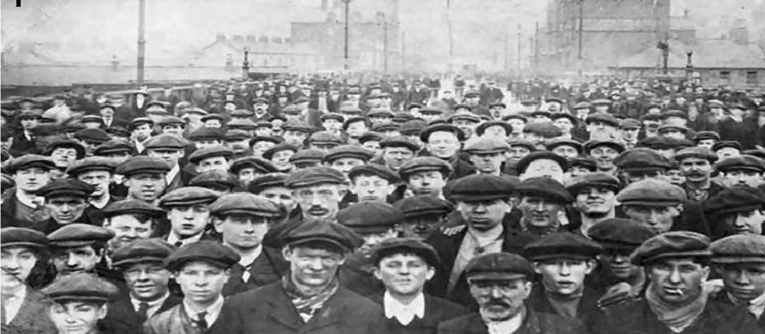
Living Conditions
Overcrowding
Disease
Alcoholism
A sense of helplessness in the face of extraordinary wealth

Slide 6
English theater and the law
VERY few houses allowed “straight” drama – Covent Garden and Drury Lane (both licensed by the king)
Most required music (“melo”) to accompany the play (“drama”).
Within the show itself and between scenes or acts (“intervals”) were little songs (some sung, some instrumental)

Slide 7
Conventions of Victorian Melodrama
Elements of Gothic drama (the Brontës – Wuthering Heights, Villette, Jane Eyre) and Romanticism (e.g. Shelley, Wordsworth, Byron Keats) – heightened emotions.
Became a theatrical form in the early 1800s with René Charles Guilbert de Pixerécourt’s LA FEMME A DEUX MARIS (The Wife of Two Husbands).
First play originally written in English to be called a “melodrama” was “A Tale of Mystery” by Thomas Holcroft.
Melodrama was a reaction against the perceived immorality of Restoration drama.

Slide 8
Characteristics of Melodrama
Convention | Examples | In RUDDIGORE (note: Gilbert plays with the conventions…sometimes exaggerating, sometimes inverting)
Exaggerated and stylized movement and extended vocal technique expressing extreme emotions and sentimentality | “Playing to the back of the house” – exaggerated eye movements, exaggerated gestures with capes, ”chewing scenery” | Despard’s first entrance with exaggerated eye make-up, black cape etc.
Stereotyped characters | Usually one dimensional; little to no change psychologically or morally throughout the play | Rose’s innocence so extreme that she does not act without consulting a book of etiquette.
Good v. Evil (moral struggle) | The human struggle between purest good (usually the poor and downtrodden) vs. pure evil (usually the rich, greedy or powerful). There is strict observance of poetic justice – good always rewarded and evil always punished. | The curse and the struggle to commit a crime a day … then compensating with multiple acts of kindness.
Audience interaction (breaking the 4th wall) | Empowering the audience. Audience members may be powerless (broadly speaking), but they can interact with the “bad guy” – tossing vegetables, etc. at the bad guy and taunting him. | N/A (?) Modest localisms added for the pleasure of the Twin Cities crowd.
Spectacular events & exotic locales | Chases, explosions, battles, fights, fierce arguments, sea voyages, supernatural events. All an attempt to help the audience forget their troubles, if only briefly. Remote islands, castles, etc. | The ghosts the gloomy castle of Ruddigore Castle in act 2.

Slide 9
The stock characters
A hero, who is moral, handsome and manly. He acts on his intuition and is in-tune to nature. And, while he believes in justice, he does not always follow the less-important rules of society.
A heroine, who is also moral in that she is innocent. She is also beautiful and courageous, but likely in need of saving.
A villain, who is evil. These characters are often dishonest, greedy, vengeful and corrupt.
A villain’s accomplice, who is usually rather idiotic and serves as comic relief.
A faithful servant, who helps the hero uncover needed information on the villain. This character also serves a comic relief.
A maidservant, who is flirty (often a romantic interest of the male servant), fun and loyal to the heroine.

Slide 10
Ruddigore for a modern audience
Ruddigore could work perfectly well “as is.” However, it’s reasonable to assume that the Victorian audience would have been extremely familiar with the tropes of melodrama making the show particularly delightful.
Modern audiences are many times removed from Victorian melodrama. What we know of it comes from parodies of parodies in cartoons or Carol Burnett (who is also becoming less known, sadly).
What might a modern analog be for Victorian melodrama….?

Slide 11
Hollywood films of the 30s, 40s and 50s
The crime drama, the potboiler, the screwball comedy, the horror movie, the psychological thriller. Film Noir, the MGM musicals of the 40s and 50s.
The Maltese Falcon | Sunset Boulevard
Double Indemnity | The Big Sleep
Murder, My Sweet | Cape Fear
Gaslight | Rebecca
Rear Window | Vertico
Signing In The Rain | The Wizard of Oz
42nd Street | Judy & Mickey “let’s put on a show” movies
Bringing Up Baby | Busby Berkeley musicals (pick one)

Slide 12
Film Noir

Slide 13
Film Noir
Film noir (/nwɑːr/; French: [film nwaʁ]) is a cinematic term used primarily to describe stylish Hollywood crime dramas, particularly those that emphasize cynical attitudes and sexual motivations. Hollywood's classical film noir period is generally regarded as extending from the early 1920s to the late 1950s. Film noir of this era is associated with a low-key, black-and-whitevisual style that has roots in German Expressionist cinematography. Many of the prototypical stories and much of the attitude of classic noir derive from the hardboiled school of crime fiction that emerged in the United States during the Great Depression.
The term film noir, French for "black film" (literal) or "dark film" (closer meaning),^{[1]} was first applied to Hollywood films by French critic Nino Frank in 1946, but was unrecognized by most American film industry professionals of that era.^{[2]} Cinema historians and critics defined the category retrospectively. Before the notion was widely adopted in the 1970s, many of the classic film noir^{[a]} were referred to as "melodramas". Whether film noir qualifies as a distinct genre is a matter of ongoing debate among scholars.
Film noir encompasses a range of plots: the central figure may be a private investigator (The Big Sleep), a plainclothes policeman (The Big Heat), an aging boxer (The Set-Up), a hapless grifter (Night and the City), a law-abiding citizen lured into a life of crime (Gun Crazy), or simply a victim of circumstance (D.O.A.). Although film noir was originally associated with American productions, the term has been used to describe films from around the world. Many films released from the 1960s onward share attributes with film noirs of the classical period, and often treat its conventions self-referentially. Some refer to such latter-day works as neo-noir. The clichés of film noir have inspired parody since the mid-1940s.
Greed, villainy, sex, murder, justice, death, lust.

Slide 14
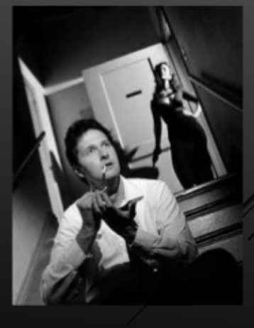
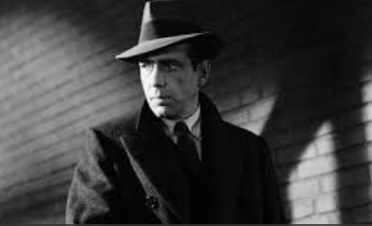
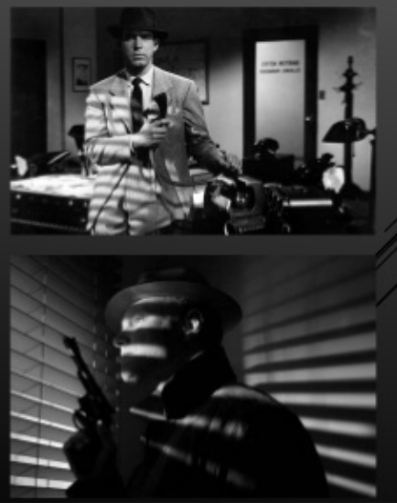
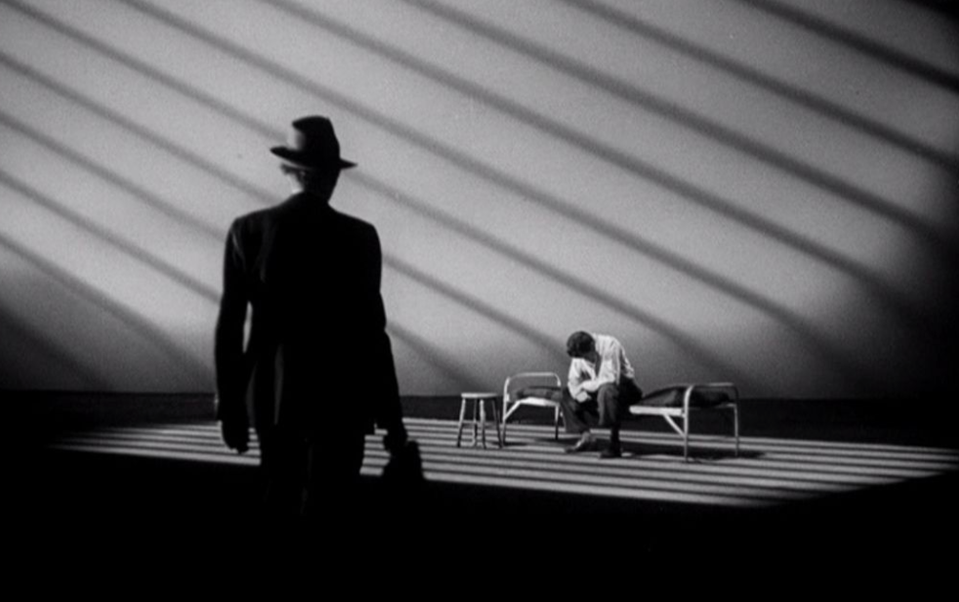
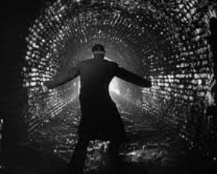
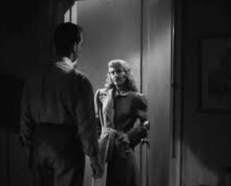
The Look of Noir: b/w with low lighting and shadows.

Slide 15
1950s Psychological Thrillers

Slide 16
1950s Psychological Thrillers Esp. Hitchcock….

Slide 17
Hitchcock Thrillers
Climactic plot twist.
The cool platinum blonde.
The presence of a domineering mother in someone's life
An innocent man accused.
Restricting the action to a single setting to increase tension (e.g. Lifeboat, Rear Window).
Characters who switch sides and/or who cannot be trusted.
Tension building through suspense to the point where the audience enjoys seeing the character in a life-threatening situation (e.g. Vertigo).
Average people thrust into strange or dangerous situations (e.g., Psycho, North by Northwest, The Man Who Knew Too Much).
Bumbling or incompetent authority figures, particularly police officers.
Use of darkness to symbolize impending doom (dark clothing, shadows, smoke, etc.)
Strong visual use of famous landmarks (Statue of Liberty, Mount Rushmore, Forth Rail Bridge, Golden Gate Bridge, Albert Hall, British Museum, Piccadilly Circus, etc.)
Mistaken identity (e.g. North by Northwest, Frenzy).
The use of a staircase as a motif for impending danger or suspense.

Slide 18
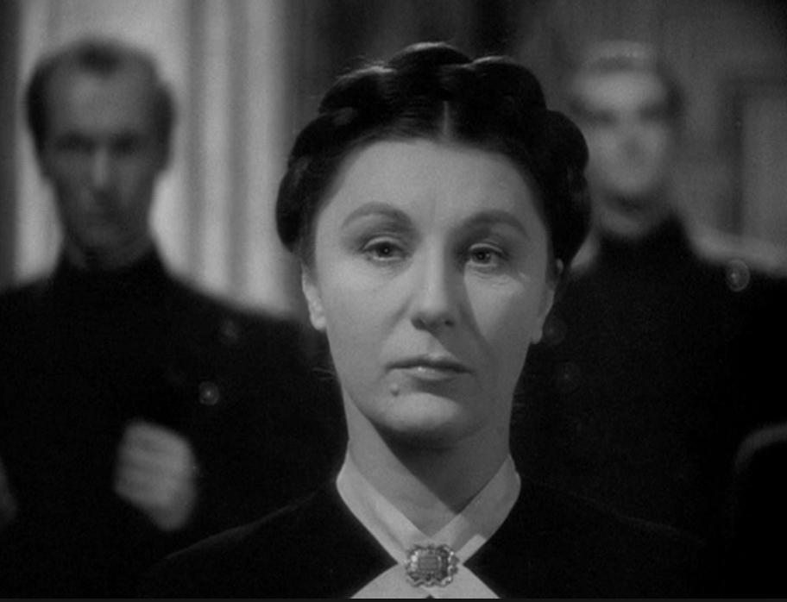
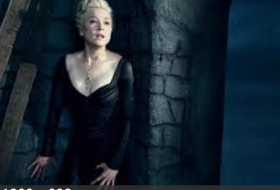
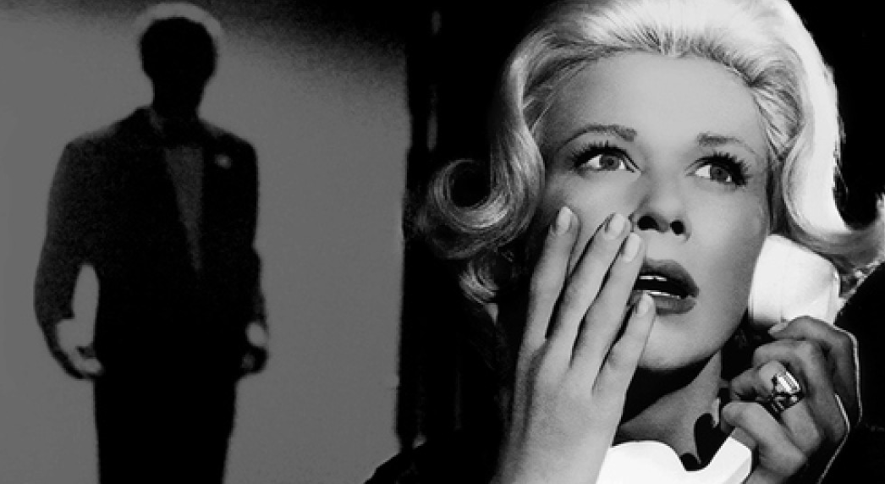
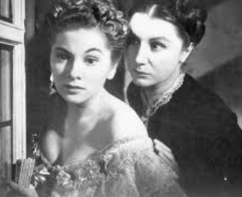
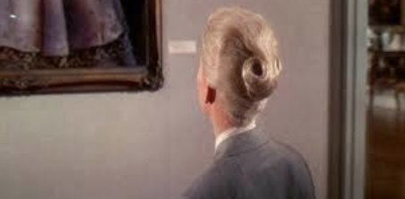
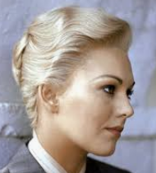
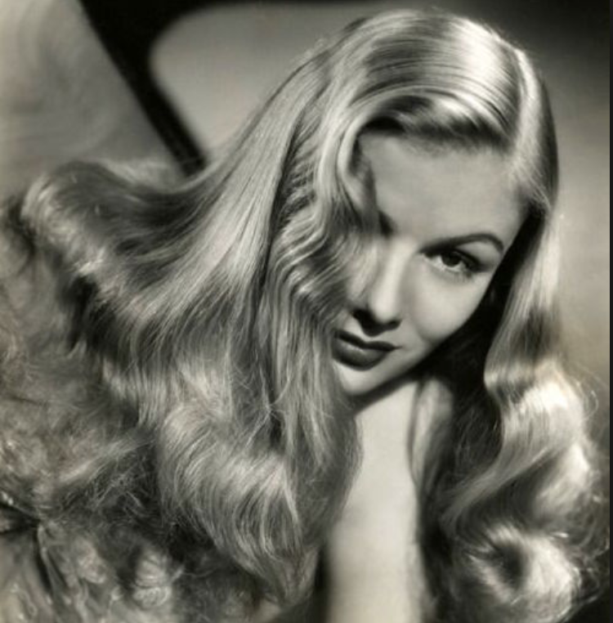
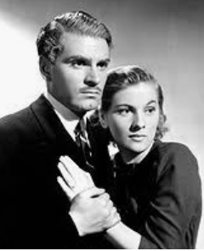
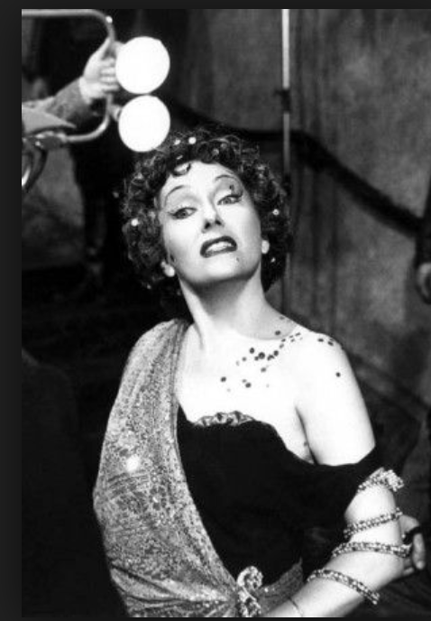
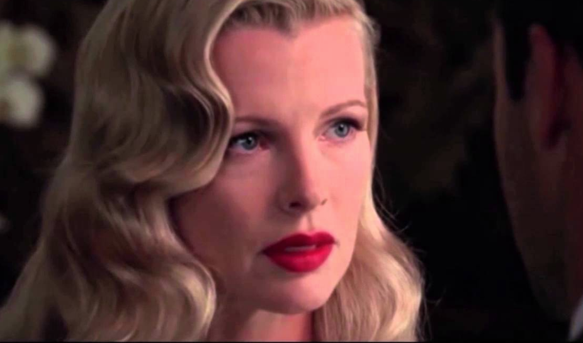
Psychological Thrillers

Slide 19
Thought Starters on Characters
Original | Options
Dame Hannah | Mrs. Danvers. Mysterious and severe.
Rose | Doris Day (Midnight Lace/The Man Who Knew Too Much), Judy Garland circa Easter Parade/Meet Me In St Louis
Zorah and Ruth | Veronica Lake
Townspeople | Pub owners (husband/wife), nurse, doctor, country gentleman, mysterious woman, mournful widow, fisherman, teacher, knitting enthusiast (always working on something that reflects the mood of the scene), etc. (See me for assignments.)
Mad Margaret | Norma Desmond – her rantings come from an array of famous old films…including Sunset Boulevard and All About Eve.
Richard | Errol Flynn (a delightful rogue back from the war)
Robin (Ruthven) | Jimmy Stewart (It’s a wonderful life) or Henry Fonda (early: Jezebel, The Lady Eve) early Cary Grant (Arsenic & Old Lace, Bringing Up Baby); Clifton Webb
Despard | Humphrey Bogart/Sam Spade or Edward G Robinson, Vincent Price
Adam | Act 1: John Gielgud? Alfred (Michael Caine/Batman) Act 2: Max from Sunset Boulevard
Bridesmaids | Bridesmaids from central casting (waiting for their next movie)…all as Veronica Lake?
Roderic | Orson Welles
Bucks and Blades | Dreamboats circa 1949 (Farley Granger, Montgomery Clift, Rock Hudson)

Slide 20
Thought Starters on changes
Original Settings | Options
Act 1: Sea side cottage circa 1840 | English countryside beach 1940s/50s. (So, “as is” except for year.)
Act 2: Castle Ruddigore (decayed castle built circa 1650) | Much like the original, but a library setting for new approach to the portraits.
Original Approach | Revised Options
Portraits that come to life – the ghosts – in the castle | A moody noir scene with Robin sipping a scotch watching slides of his ancestors with a high ball in one hand and the remote in the other. (see photo). Smoking a cigarette. The ancestors are projected a screen that is hidden behind a wall of books. The screen disappears amidst a cascade of fog and the ancestors walk through.
”Choose a word that is pregnant with mystery and possibility: Basingstoke.” | ”Choose a word that is pregnant with mystery and possibility: Rosebud. Coon Rapids…Basingstoke.”
The black cape of Despard (then Robin) | The trenchcoat of Sam Spade

Slide 22
THE SET!
Larry R.

Slide 23
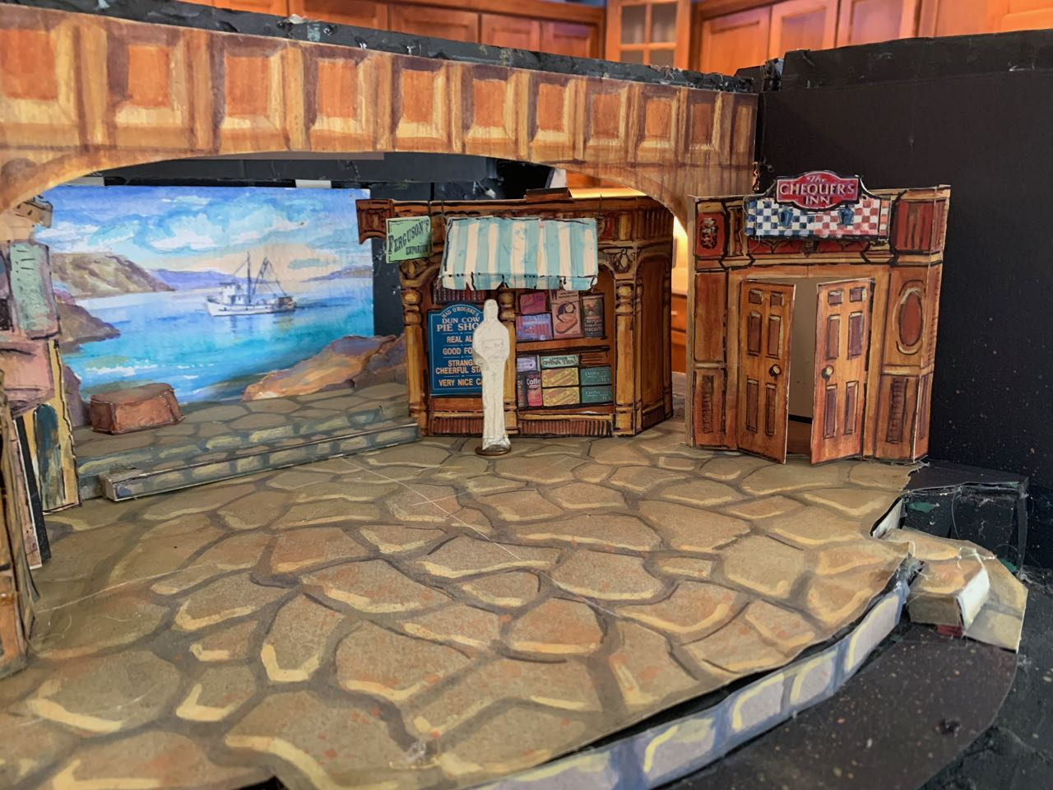
The Set: Act 1

Slide 24
The Set: Act 1

Slide 25
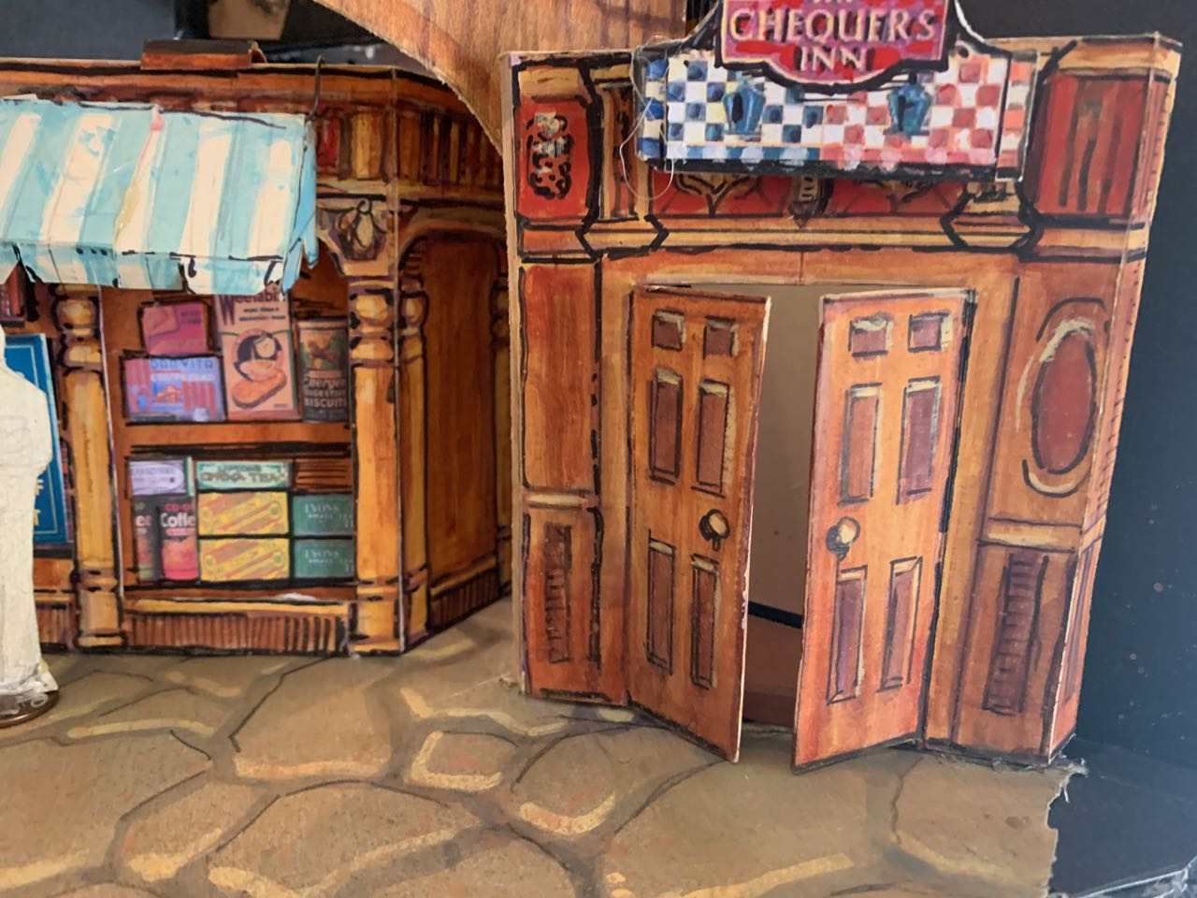
The Set Act 1

Slide 26
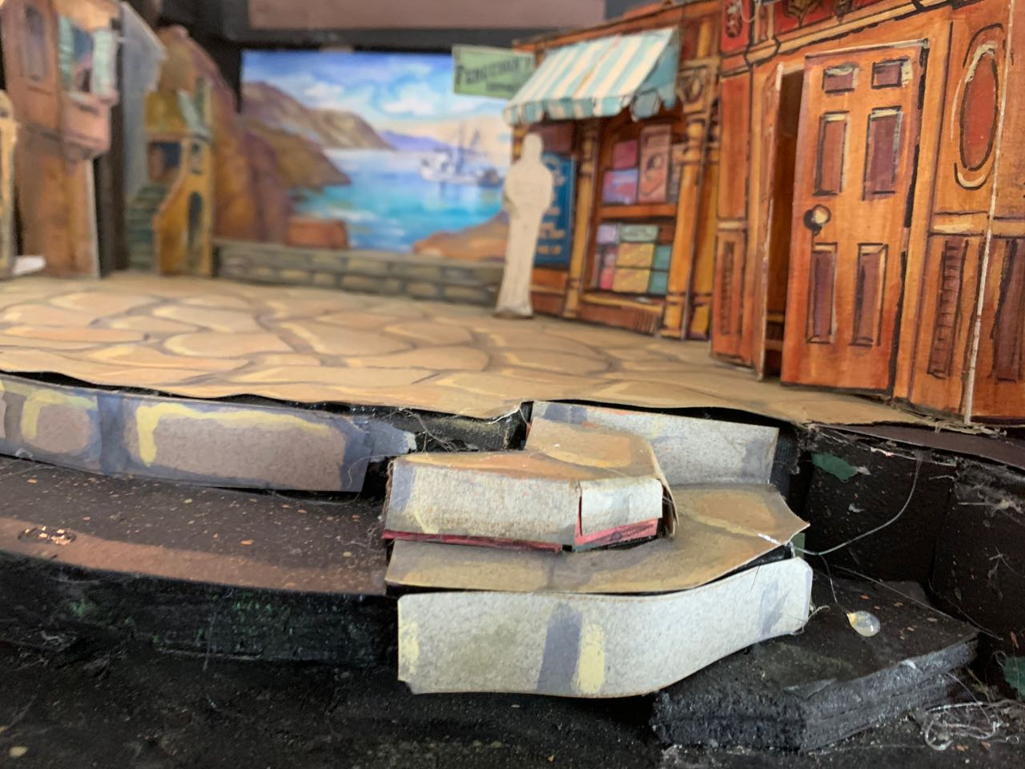
The Set: Act 1

Slide 27
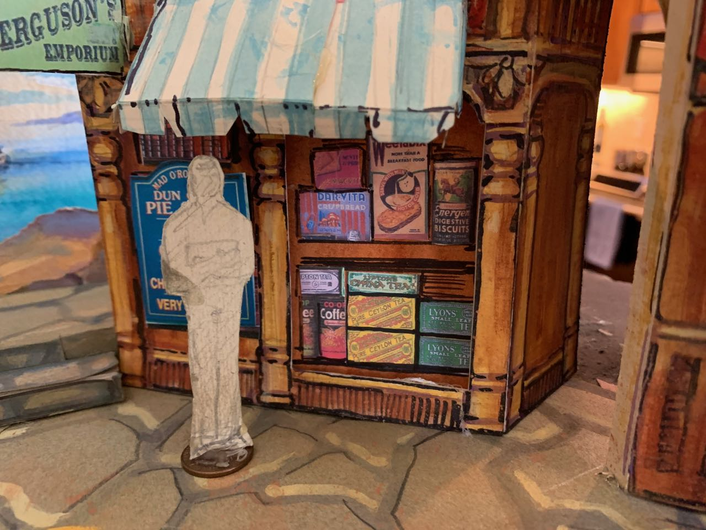
The Set: Act 1

Slide 28
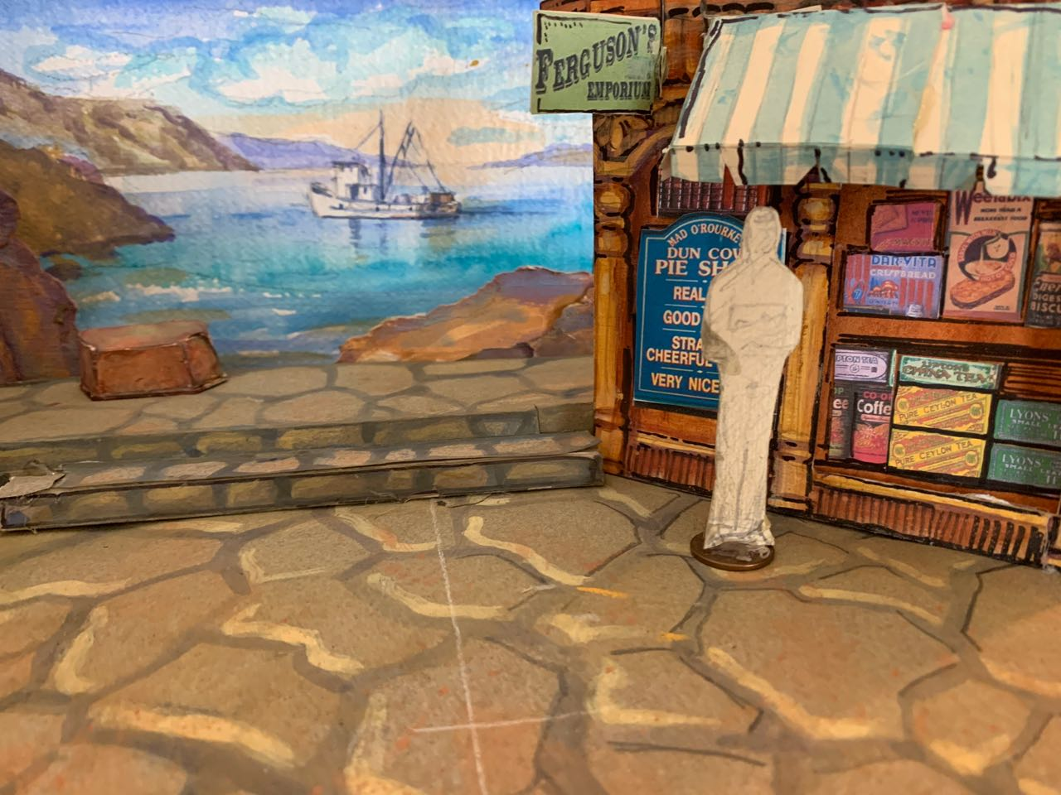
The Set Act 1

Slide 29
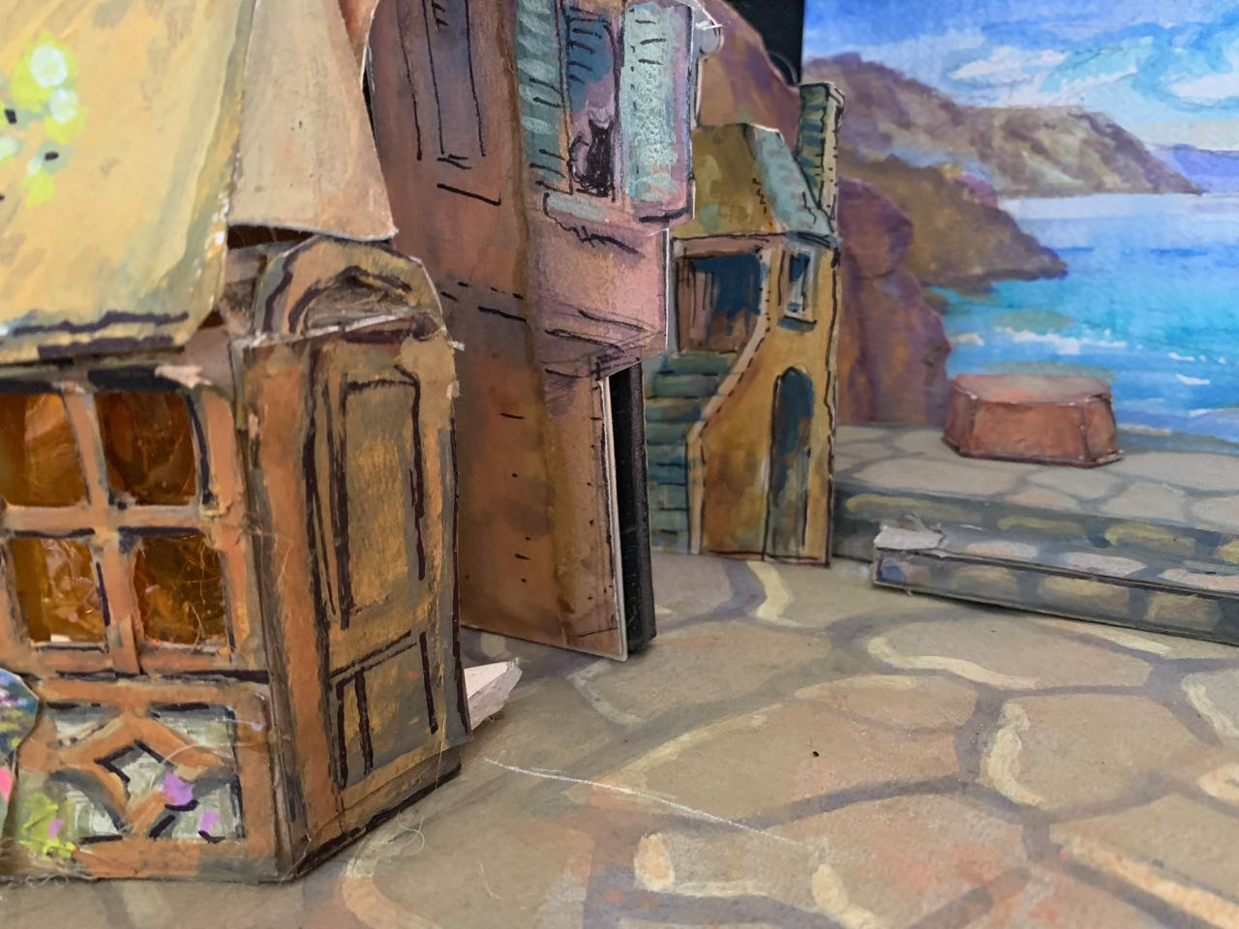
The Set: Act 1

Slide 30
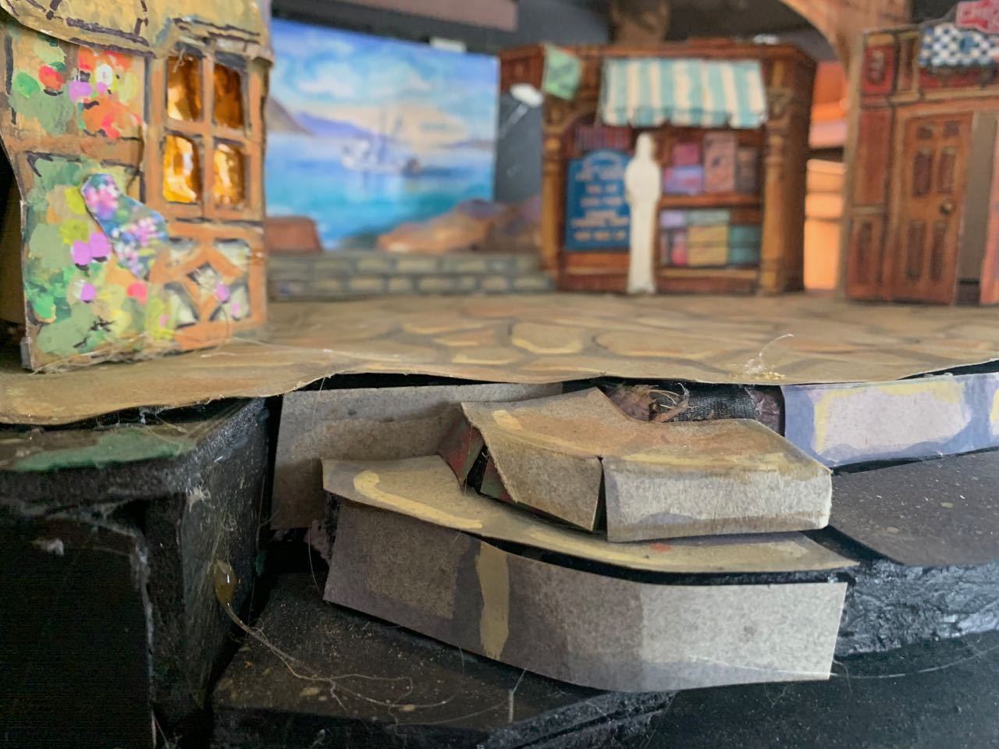
The Set: Act 1

Slide 31
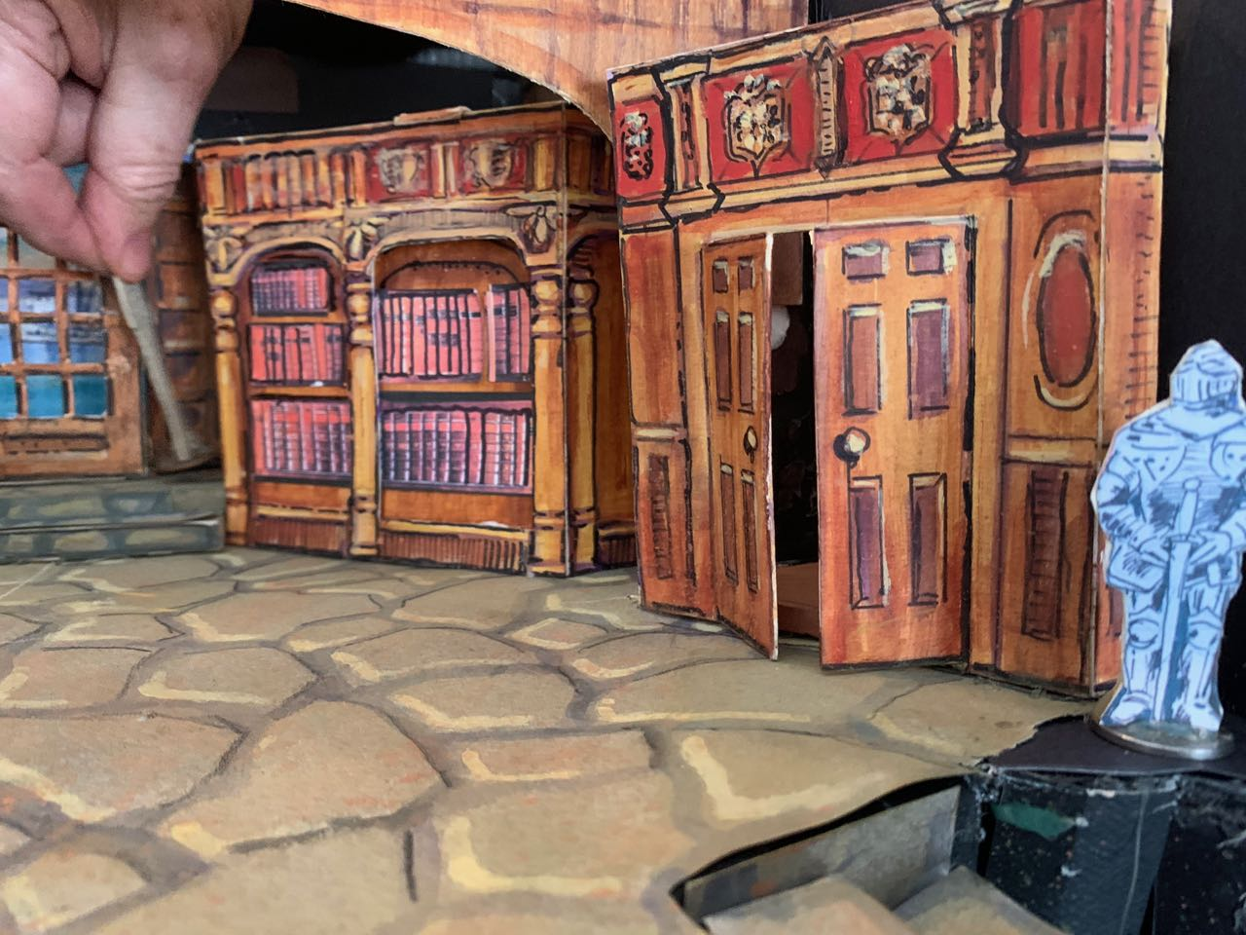
The Set: Act 2

Slide 32
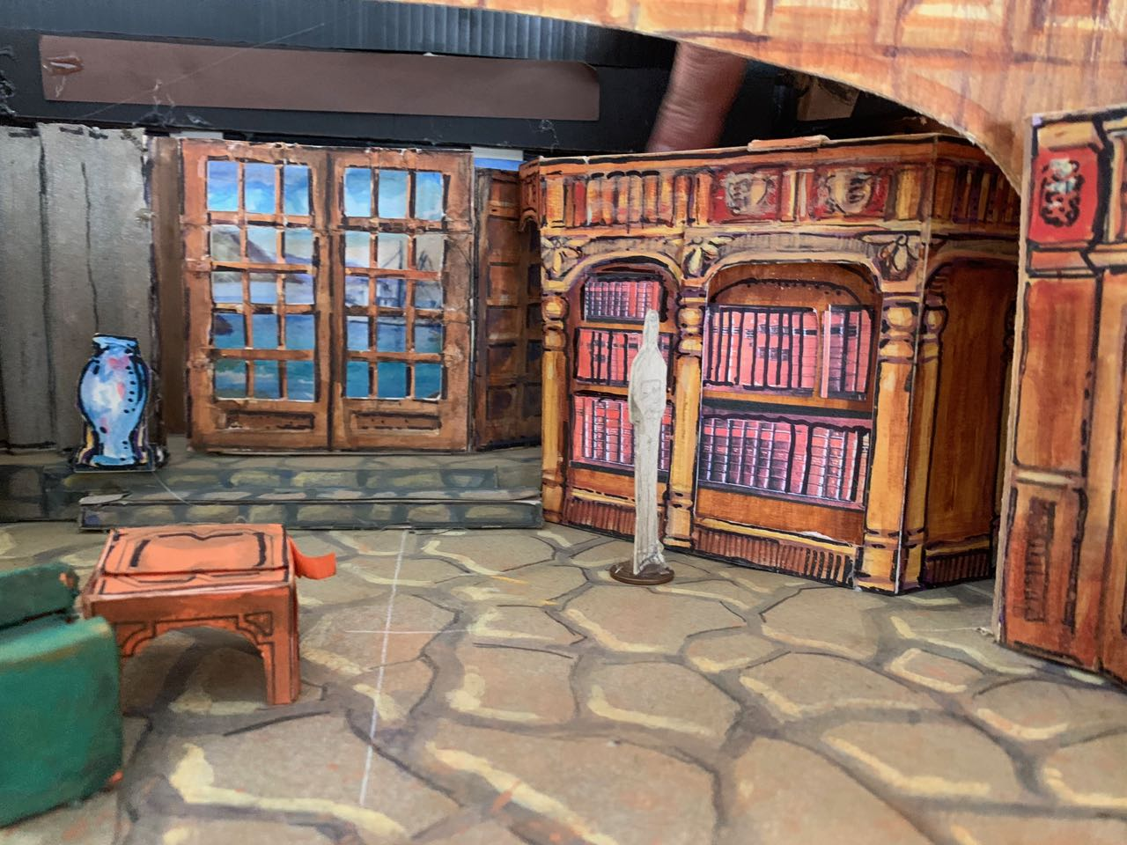
The Set: Act 2

Slide 33
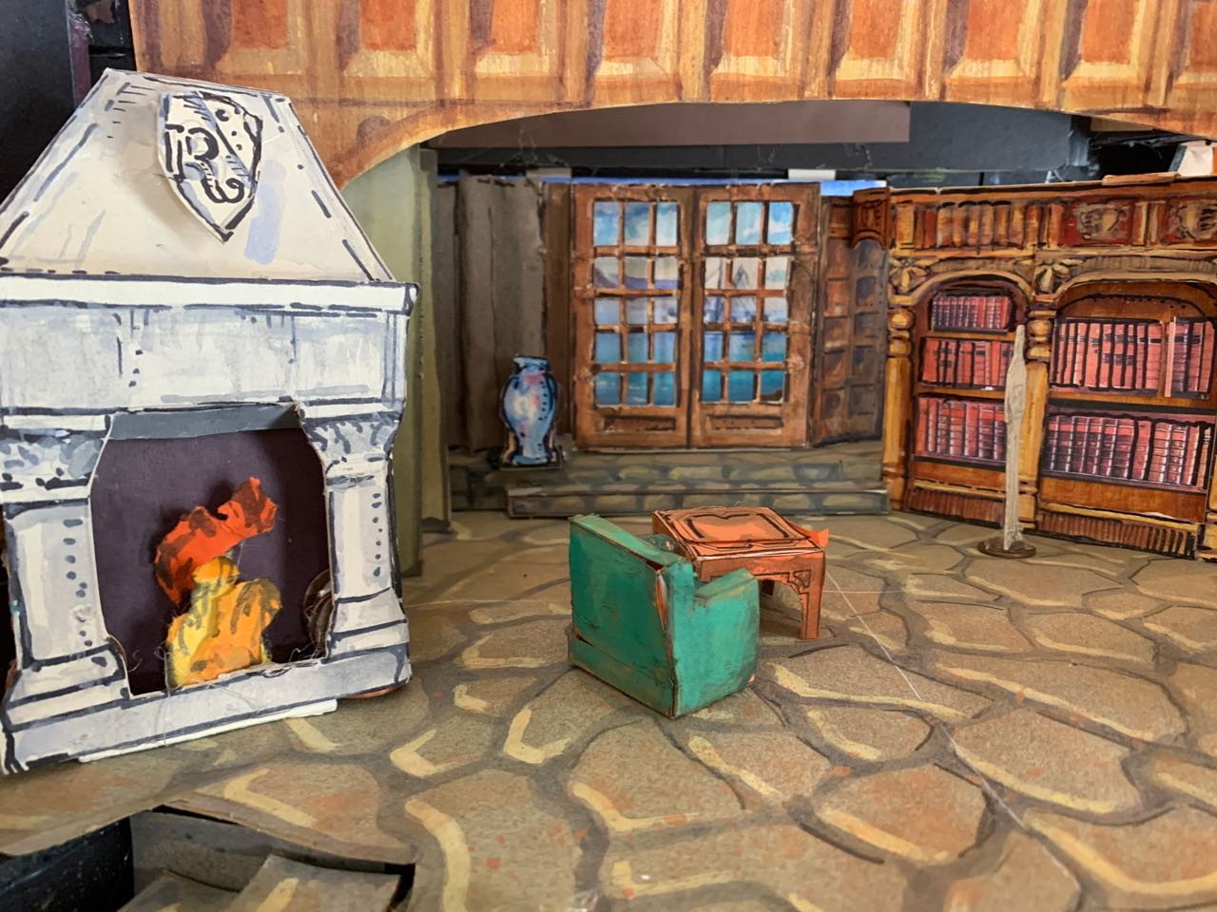
The Set: Act 2

Slide 34
The Costumes!
Barb P.

Slide 35
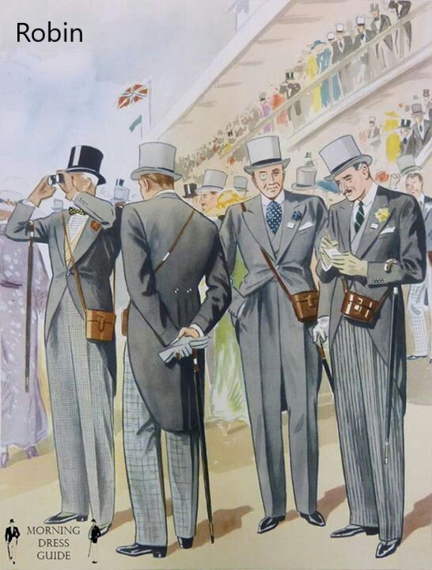
Robin

Slide 36
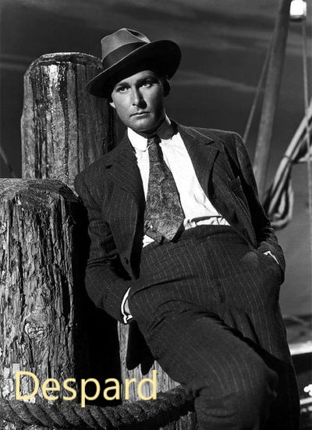
Despard

Slide 37
Richard Dauntless

Slide 38
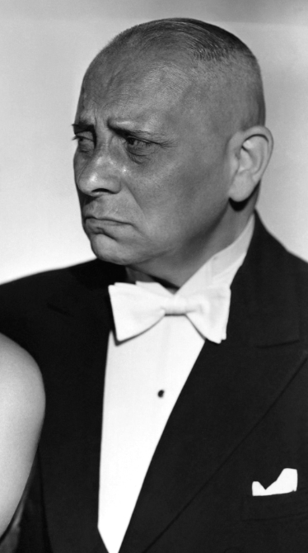
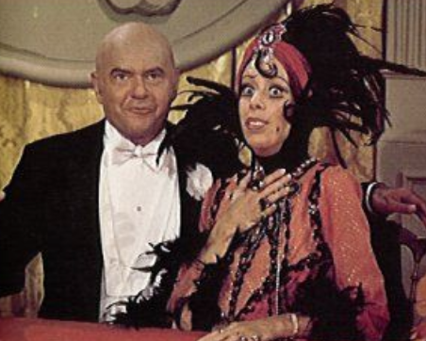
Old Adam

Slide 39
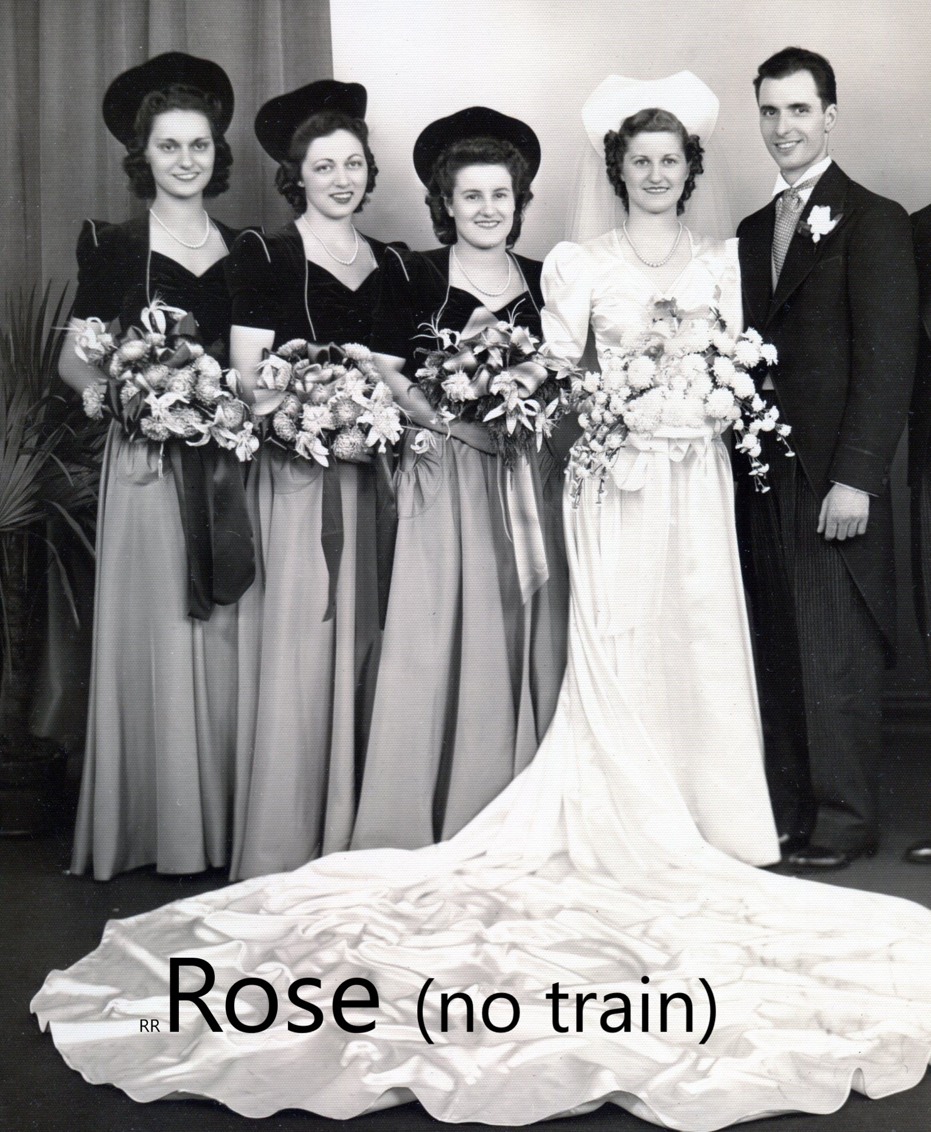

Slide 40
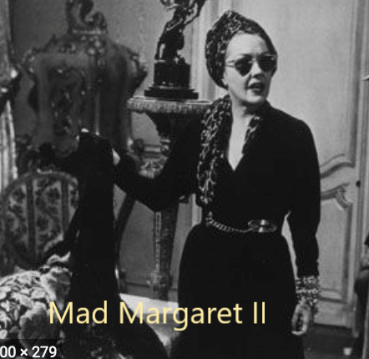
Despard

Slide 41
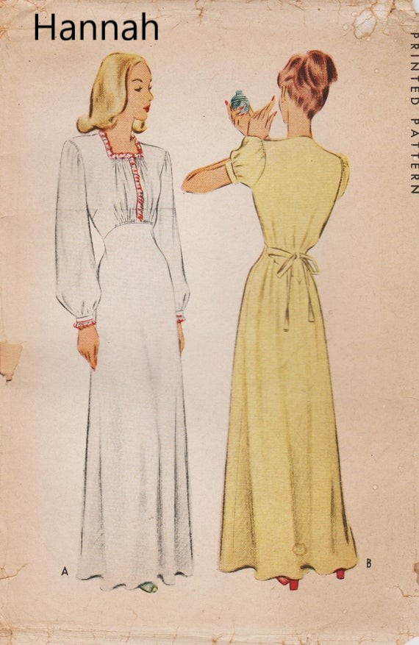
Despard

Slide 42
Ushers/ Cell phone Song

Slide 43
Despard

Slide 44
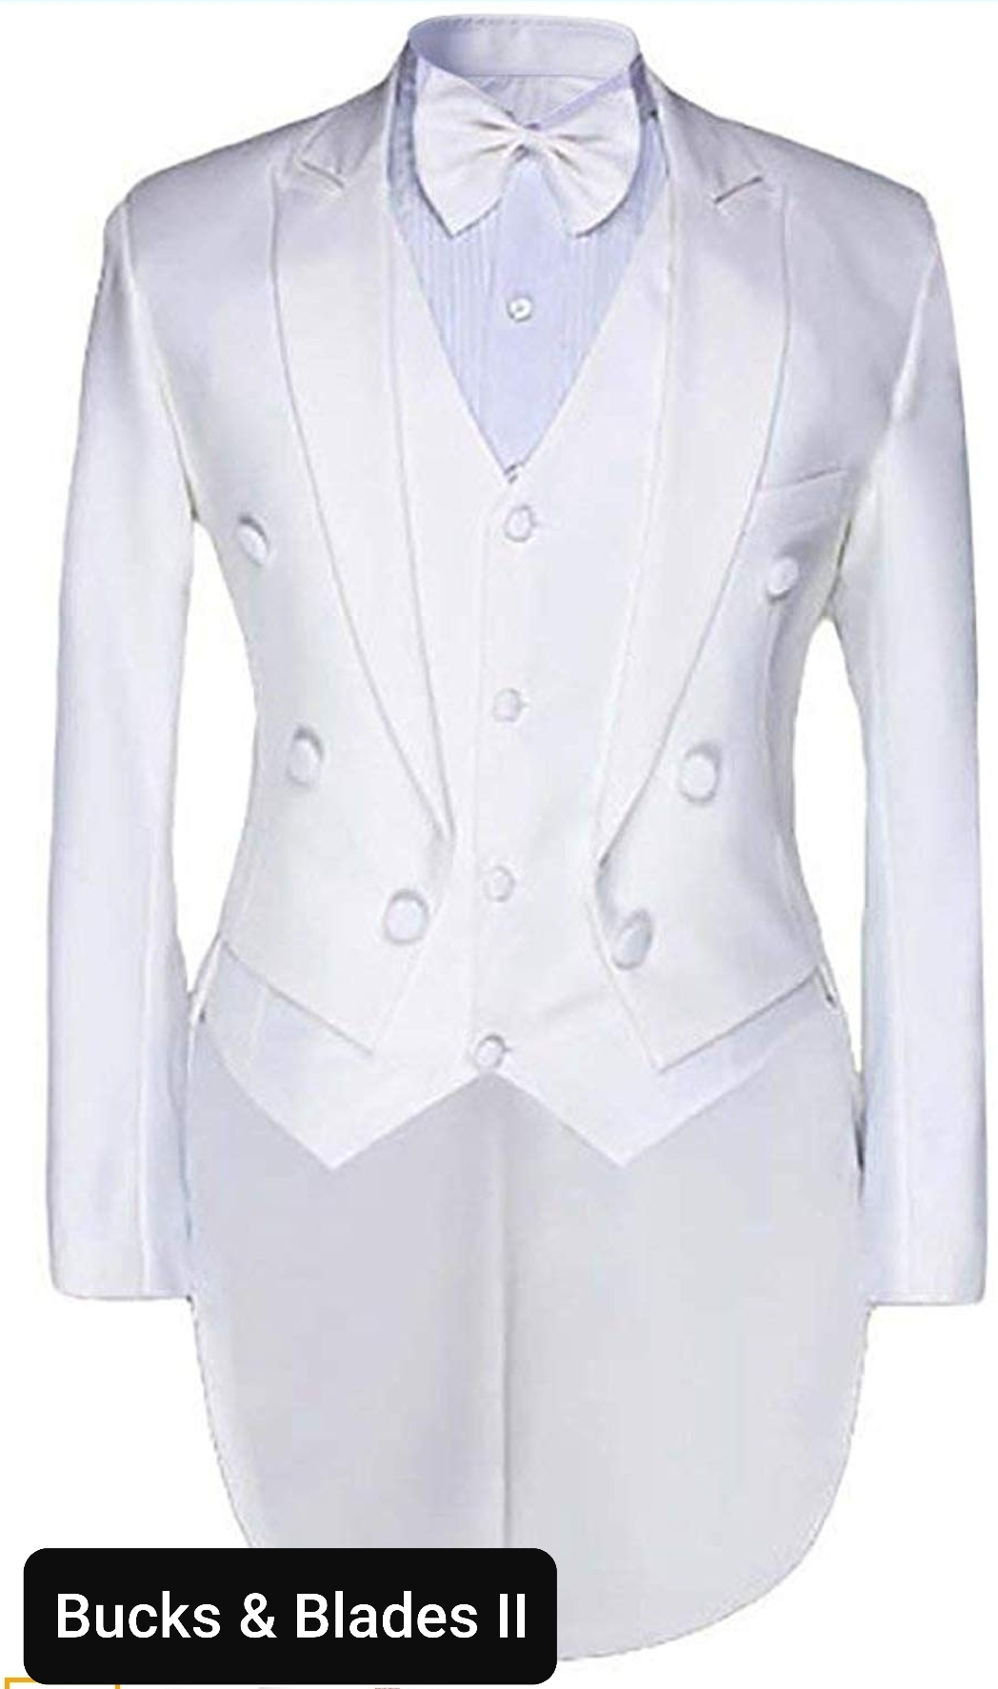
Despard

Slide 45
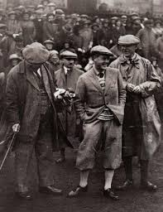
Male Townsfolk

Slide 46
Female Townsfolk

Slide 47
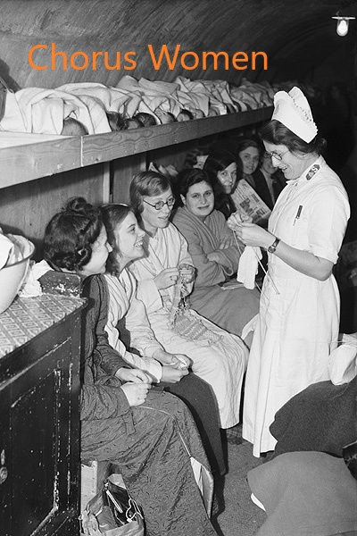

Slide 48
Despard

Slide 49
Ancestors/Ghosts!
Boo!

Slide 50
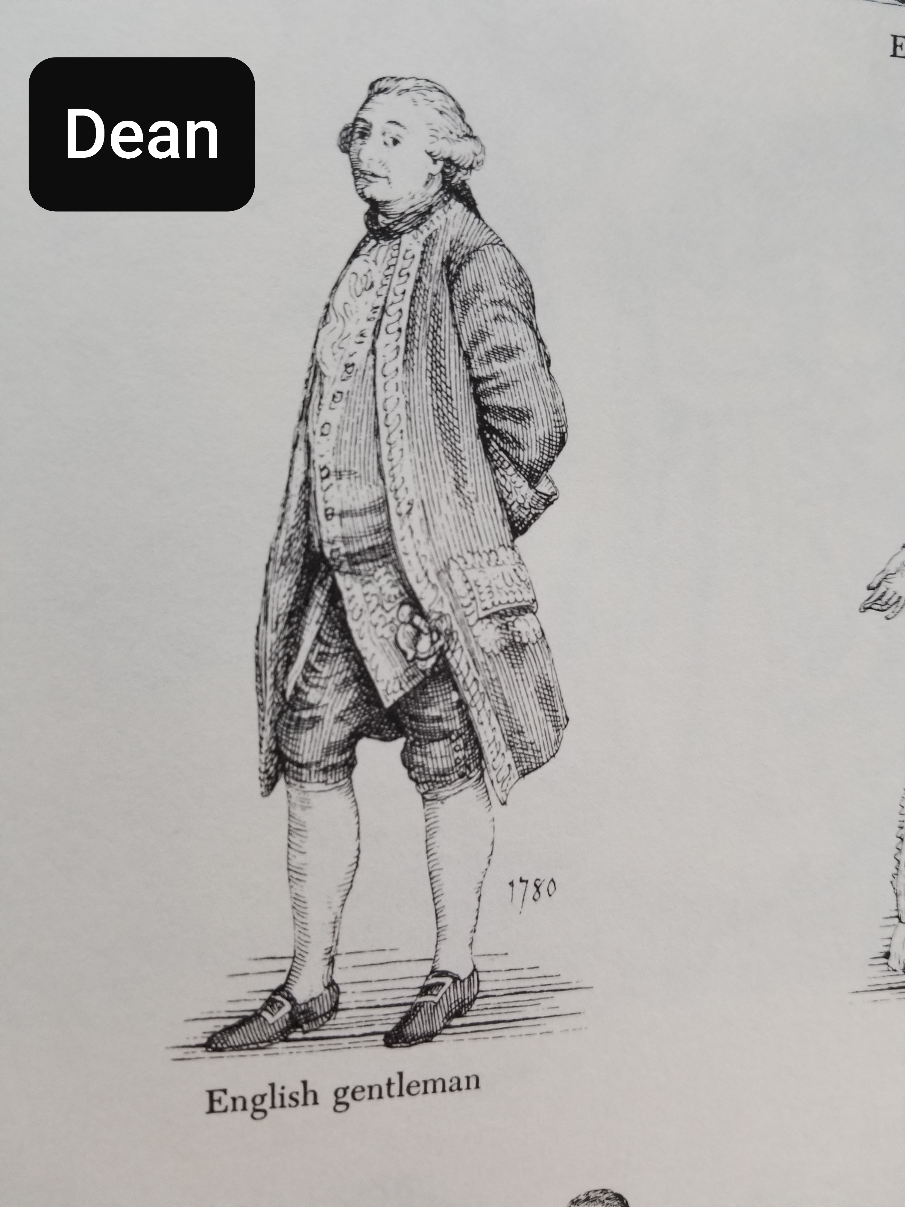
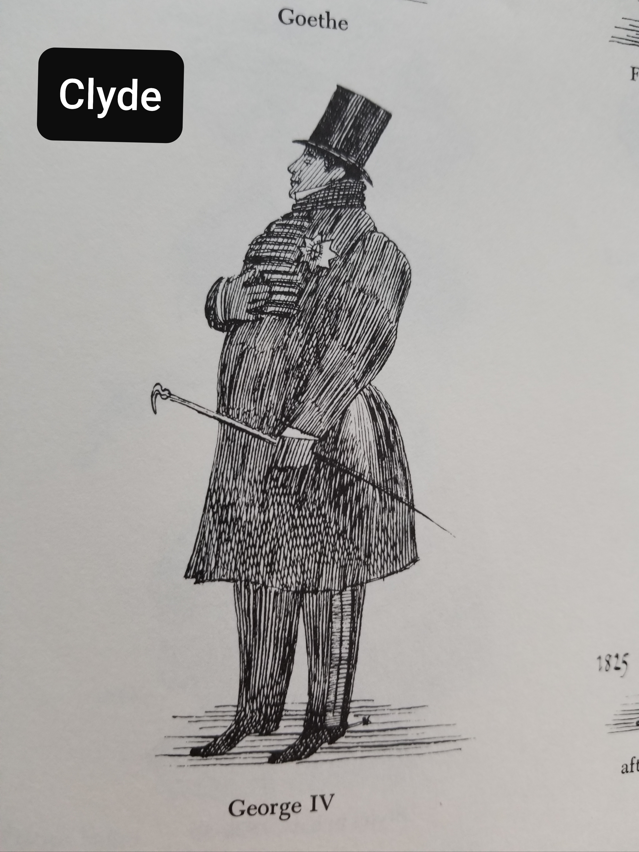
Despard

Slide 51
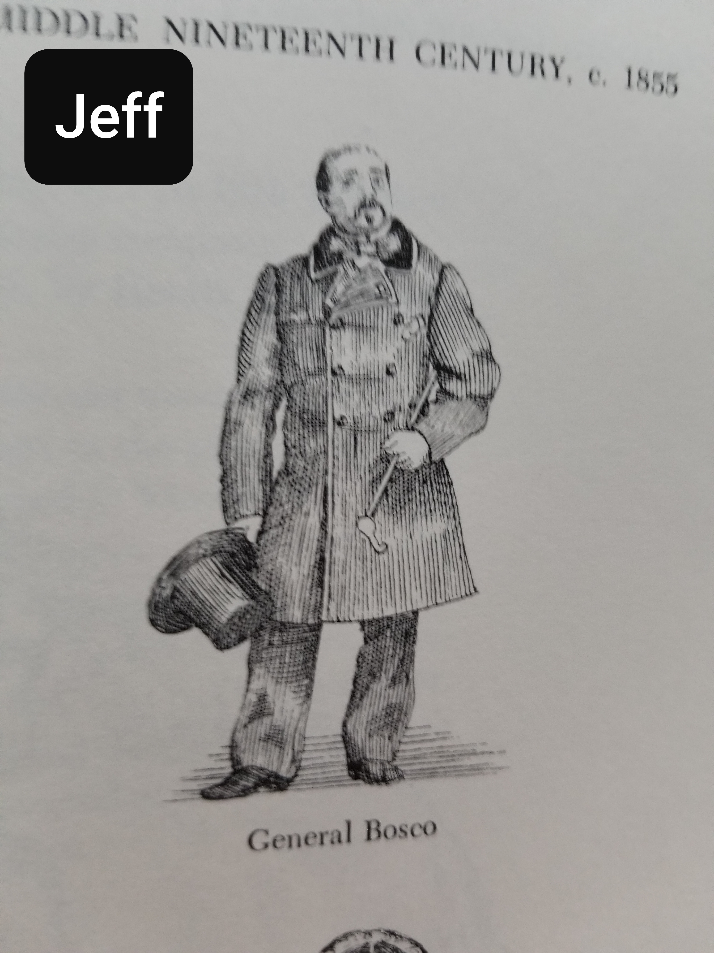
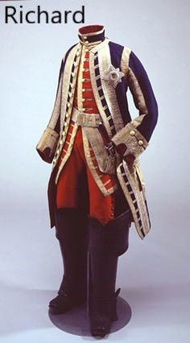
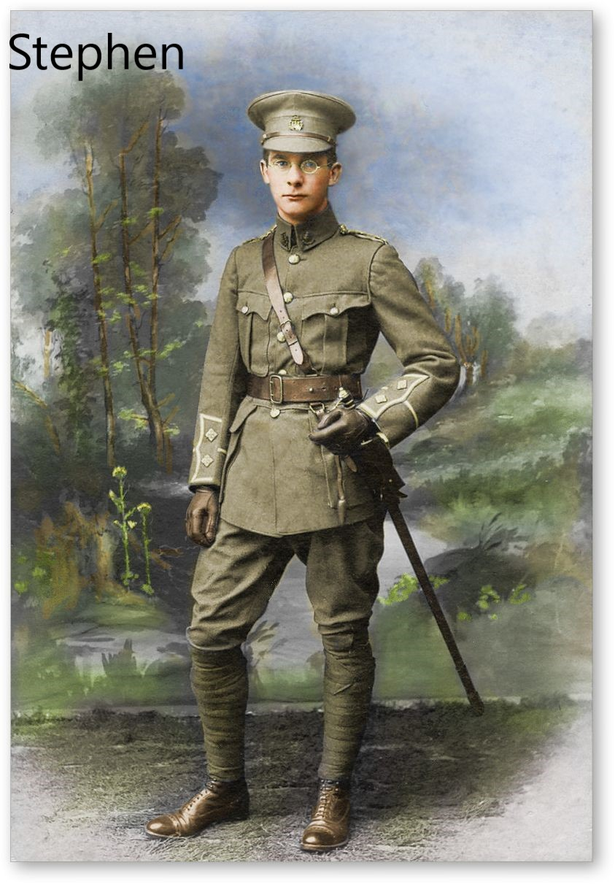
Despard

Slide 52
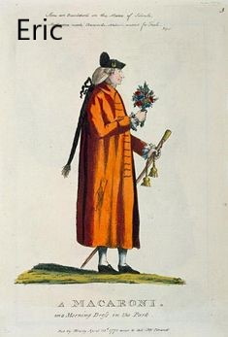
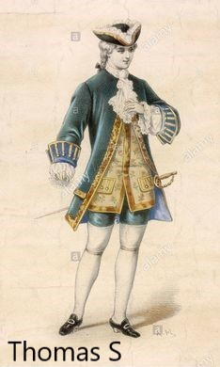
Despard

Slide 53
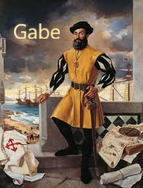
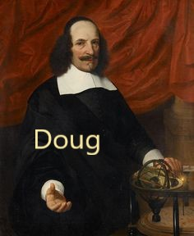

Slide 54
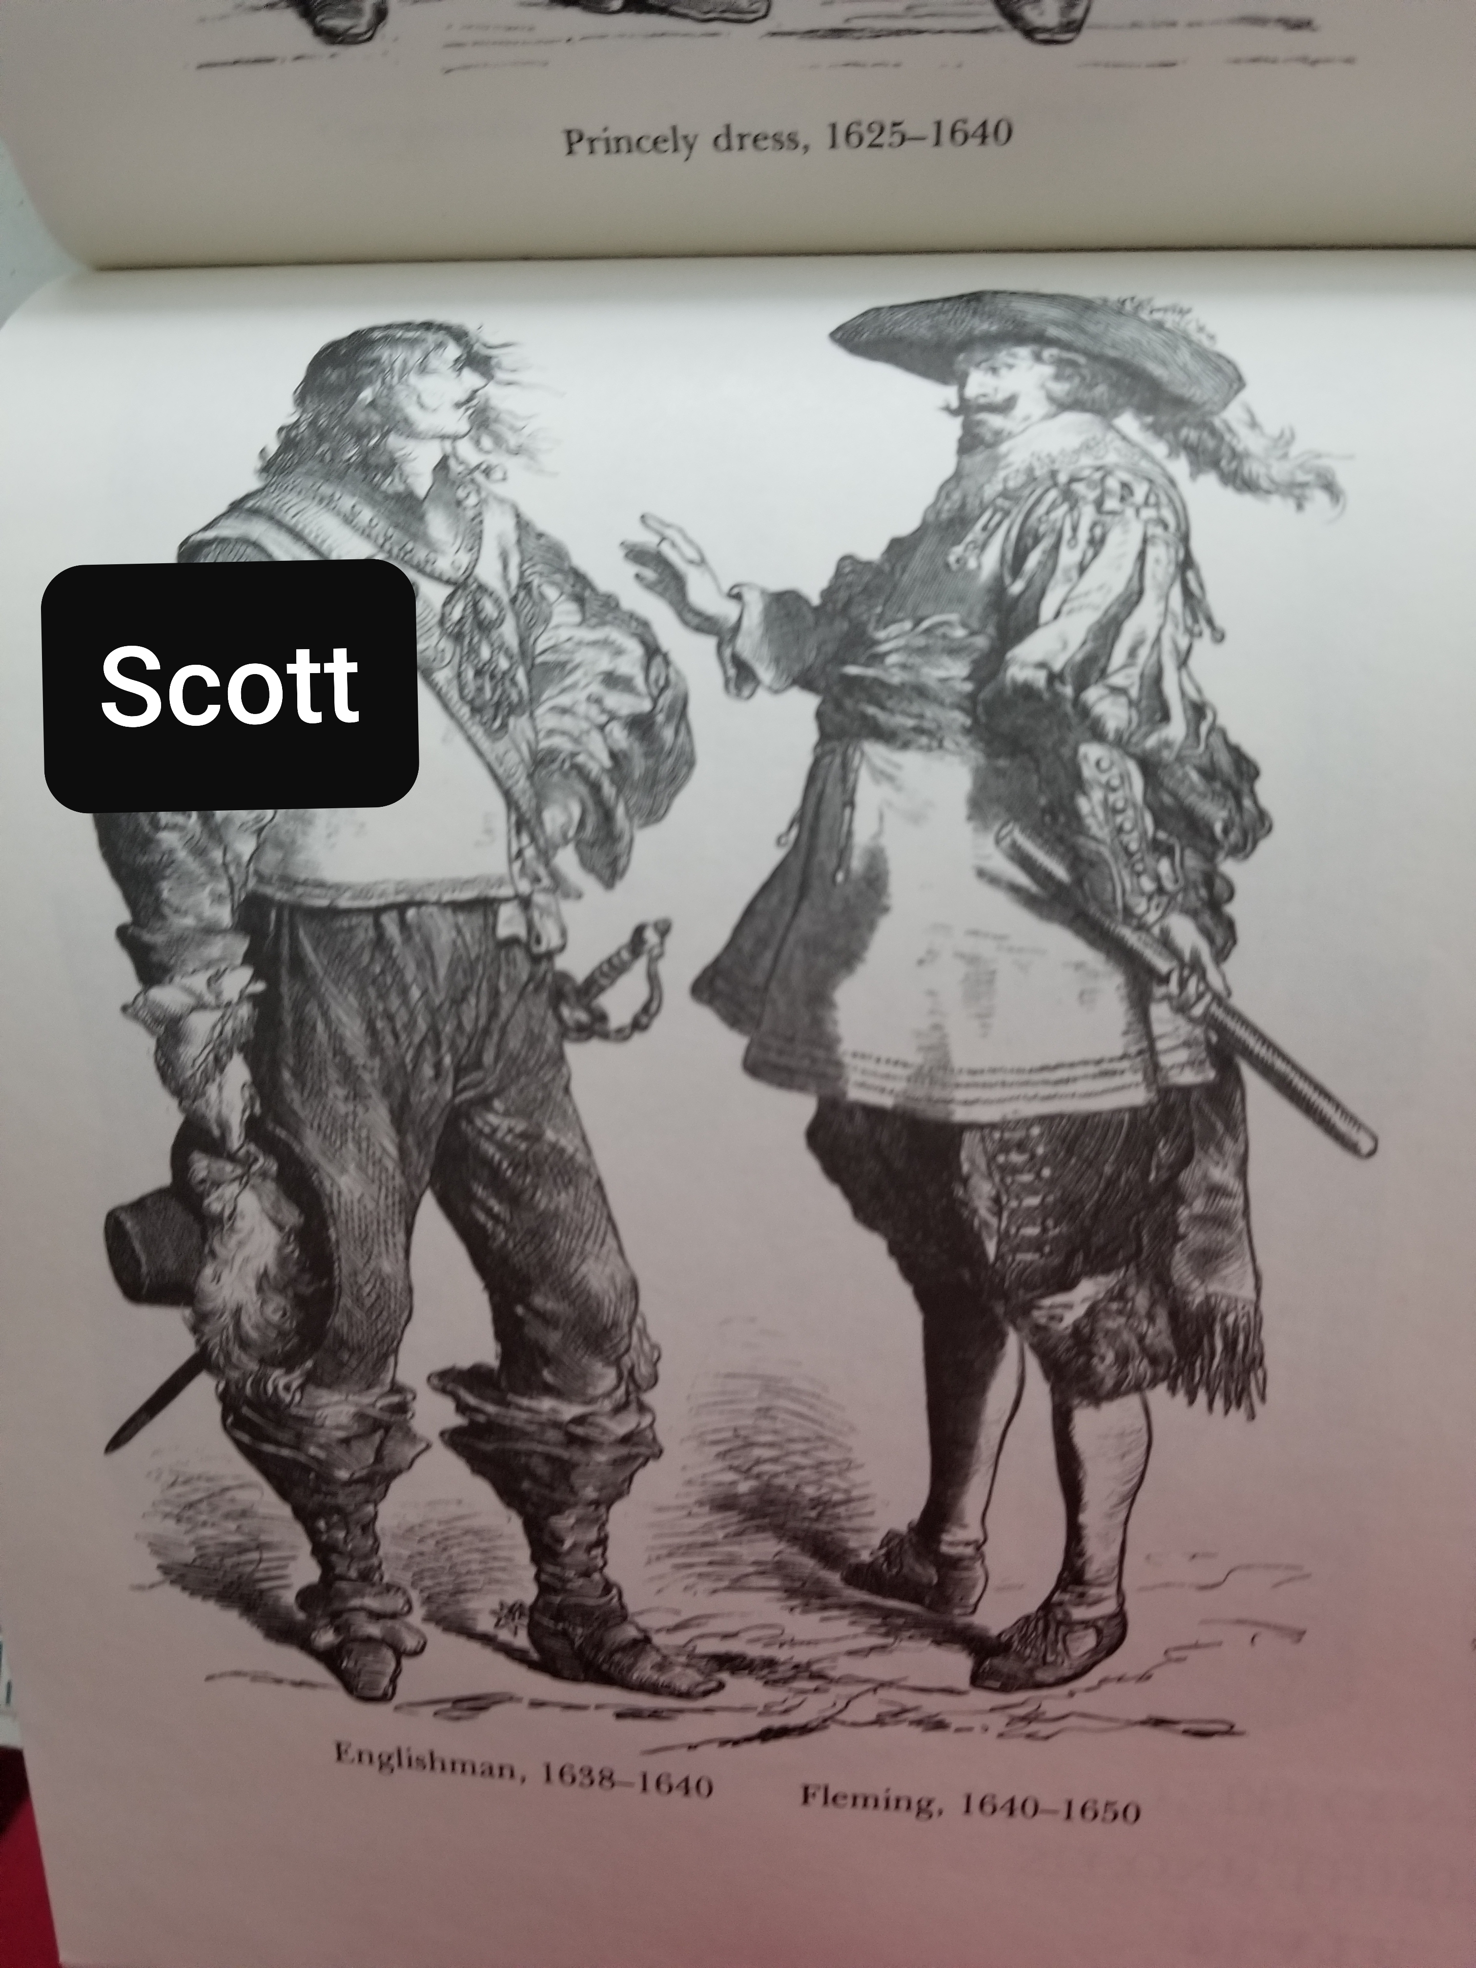
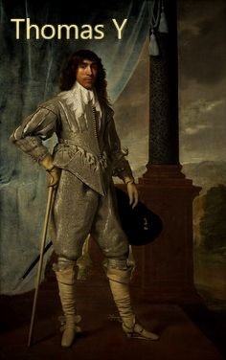

Slide 57
Getting to know you…

Slide 58
Who are we all? Counting summer shows, how many have been in…
At least 3 shows with GSVLOC
At least 5
At least 10
At least 15
At least 20
At least 30
At least 40
More than 40

Slide 59
A little bit about each one of us
Your name and who you are in the show
Something you like that starts with the letter of your name
A show (theater, tv, movie, podcast…whatever) that you love [NO JUDGING, Mr. Judgy McJudgerton!]
Something unique about yourself or something many of us may not know about you.

Slide 60
BREAK! (Then MUSIC!)

